Slide 1
Electro-Disintegration of Tensor Polarized Deuterium
Werner Boeglin
Florida International University
Miami

Slide 2
Contents
Introduction: Why the Deuteron
D(e,e’p) at Low Q²: Results and Complications
High Q²: Recent Results and Opportunities
D(e,e’p)n with Tensor Polarization
Summary

Slide 3
Introduction: Role of the Deuteron
Key system to investigate the short range part of the NN interaction (repulsive core).
Basis for SRC (structure) studies
Structure needs to be understood in detail at all length scales

Slide 4
Why Coincidence Reactions:
Obtain data closely related to the deuteron wave function (momentum distribution) with a minimum of “other contributions” such as FSI, MEC, IC etc.
Ideally ‘measure’ the momentum distribution
⇒ study the d(e,e’p) reaction

Slide 5
D(e,e’p) in PWIA
Plane Wave IA:
Hit nucleon does not interact with the recoiling system
Described by a plane wave
Experimental
Momentum distributions:

Slide 6
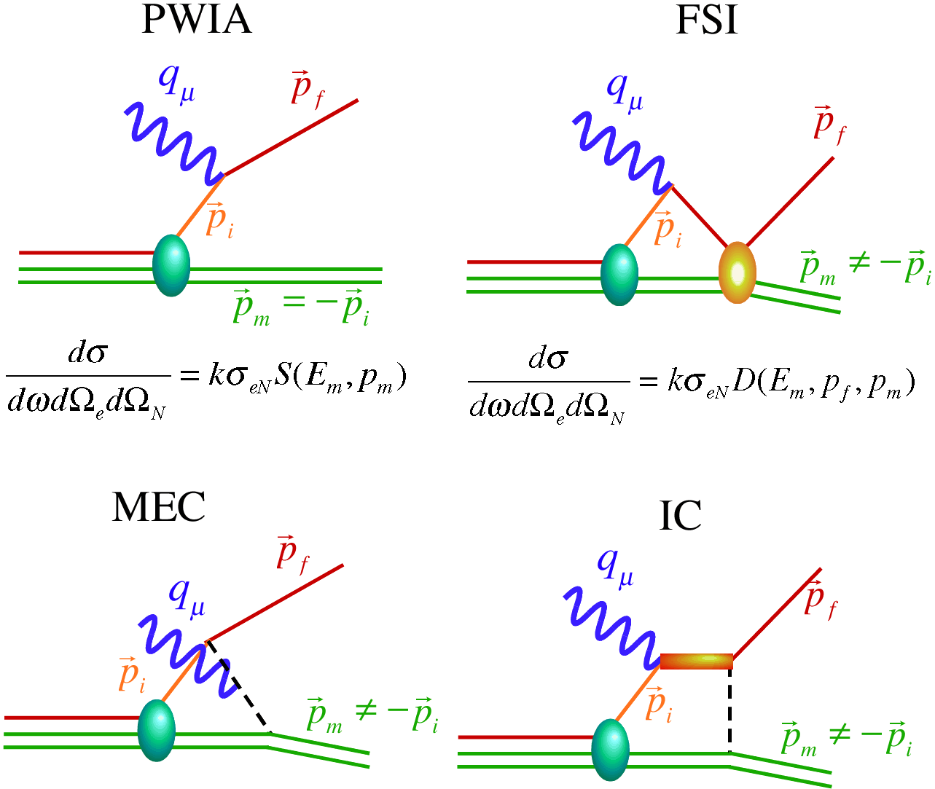
D(e,e’p) Reaction Mechanisms
reduced at certain kinematics ?
expected to be small at large Q²
supressed for x>1

Slide 7
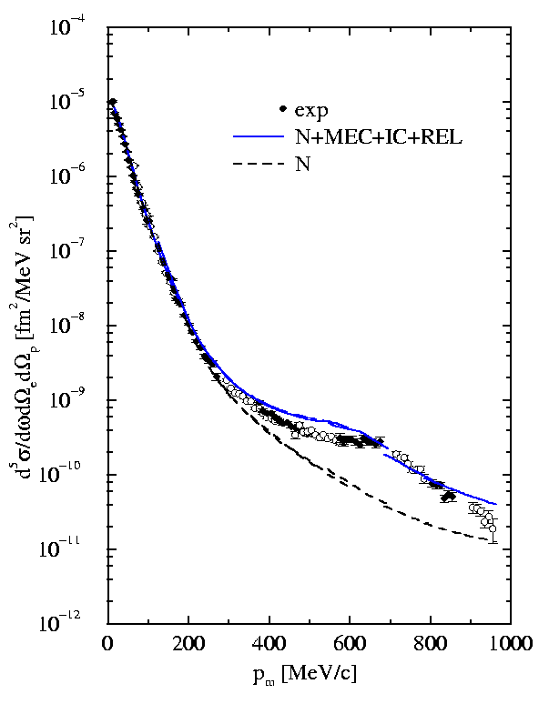
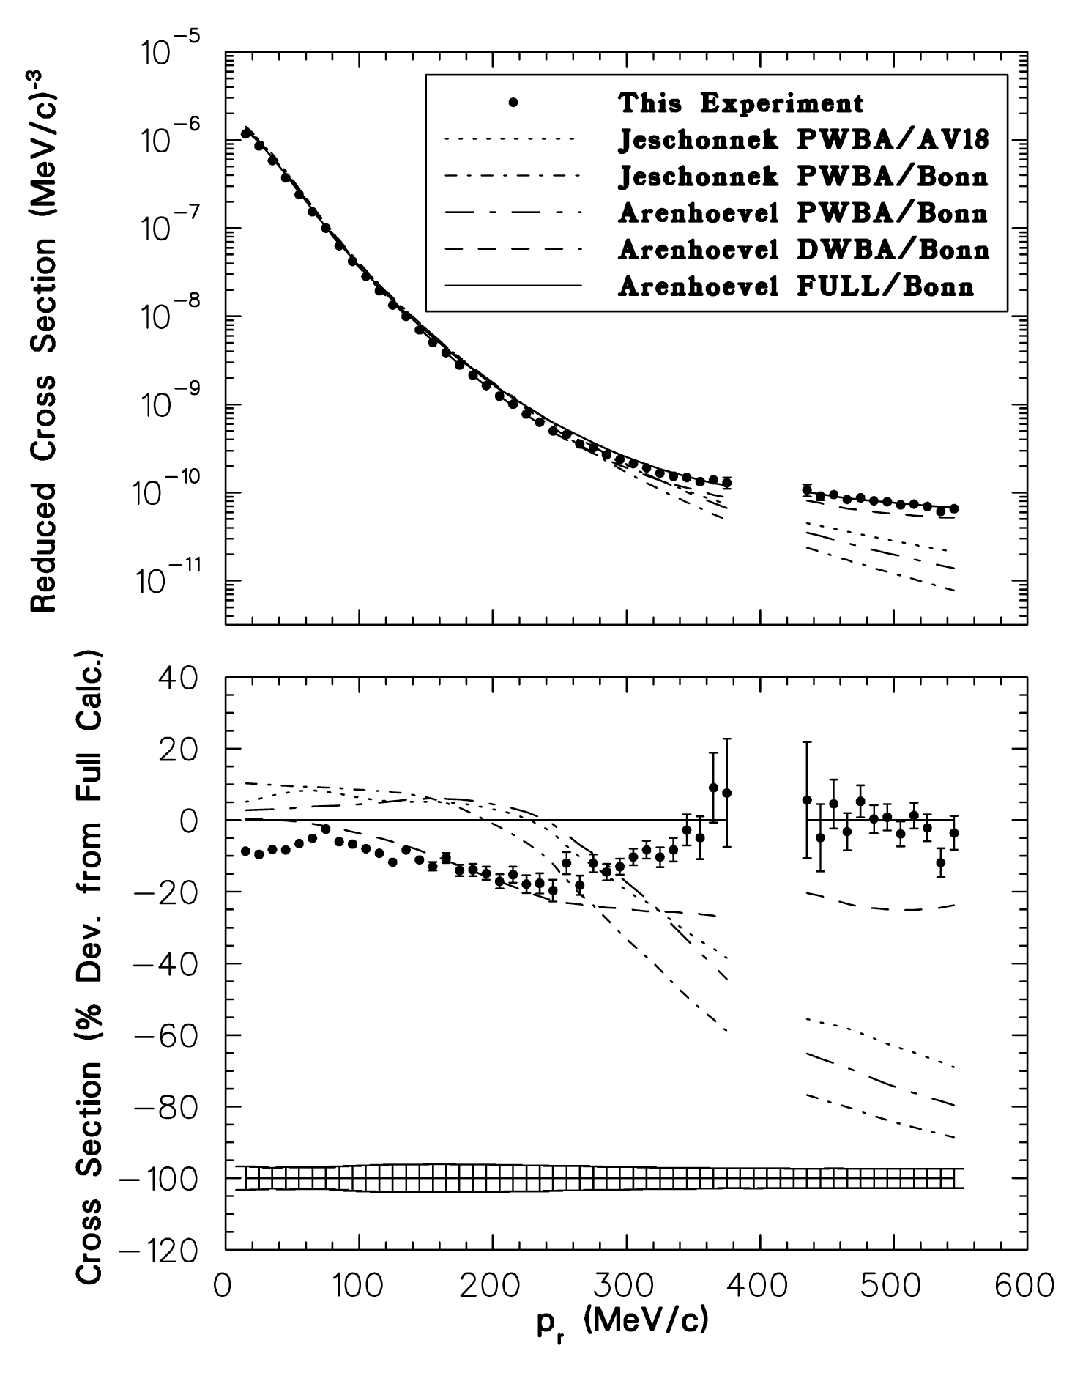
Missing Momentum Dependences
large IC+MEC
large FSI
large FSI included
MAMI Q² = 0.33 (GeV/c)² Blomqvist et al. PLB 429 (1998)
JLAB Q² = 0.67 (GeV/c)²
Ulmer et al. PRL89 (2002) 062301-1

Slide 8
The Problem with low Q²
Calculated cross section with FSI, MEC, IC and RC
(H. Arenhoevel)
FSI, MEC and IC dominate
over a large kinematic region for missing momenta above 0.2 GeV/c
Arrow: larger angles inaccessible to existing equipment

Slide 9
JLAB: CLAS and Hall A
CLAS
Simultaneous measurement of kinematics
focus on Q² dependence
e6 running period
Q² = 2, 3, 4, 5 (GeV/c)²
Further analysis possible :Data Mining
Hall A
Q² = 0.8, 2.1 and 3.5 (GeV/c)² : constant for each set
p_{miss} = 0.2, 0.4 and 0.5 GeV/c : angular distribution
angular range for each p_{miss} dependent on kinematics

Slide 10
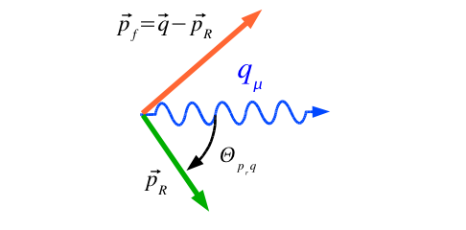
CLAS
Data: Egyian et al. (CLAS) PRL 98 (2007)
Calculation M. Sargsian
p_{m} = 250 ± 50 MeV/c
p_{m} = 500 ± 100 MeV/c

Slide 11
Summary of angular distributions
At Q² = 3.5 (GeV/c)²
Is experimental or calculated cross section
WB et al. PRL 107 (2011) 262501

Slide 12
small FSI difference
large FSI
large WF difference
small WF difference

Slide 13
each angle offset by 0.1
‘yellow’ n(p) Paris
‘cyan’ n(p) CD Bonn

Slide 14
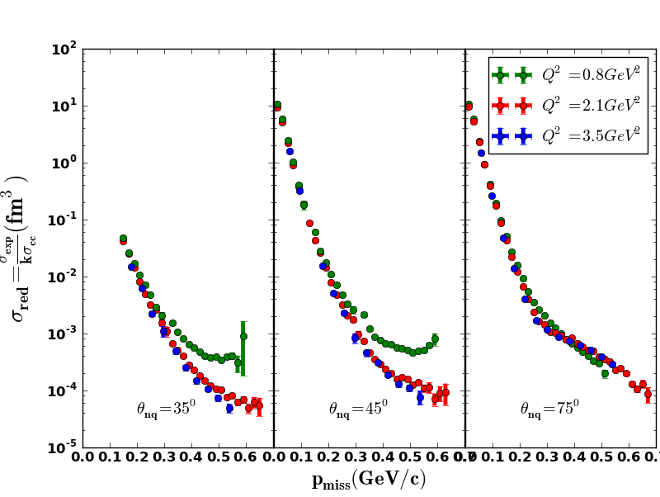
Q² dependence of momentum distribution
Thesis H. Khanal

Slide 15
Angular Distributions up to p_{m} = 1GeV/c
Calculation: M.Sargsian
FSI depend weakly on p_{m}

Slide 16
Polarized Deuterium
Experiments using internal targets
D(e,e’p)n on vector polarized Deuterium up to p_{m} = 350 MeV/c
I. Passchier, et al. PRL 88, 102302 (2002)

Slide 17
D(e,e’p)n on tensor polarized Deuterium up to p_{m} = 150 MeV/c
Z.-L. Zhou et al. PRL82, 687 (1999)

Slide 18
What can be learned?
Alignment (m) dependent momentum distributions
Structures as a result of interplay of tensor force and repulsive core
J.L.Forest et al. PRC 54, 646 (1996)

Slide 20
Originally proposed JLAB experiment
Existing NIKHEF data

Slide 21
Extraction of :
Normalized populations of magnetic substates:
Un-polarized cross section:
Cross section with polarized target:

Slide 22
with
and
One obtains:
Original proposal

Slide 23
Effects of FSI and MEC

Slide 24
Expected results:
I = 80nA, P_{zz} = 0.2
Beam time: 33 days
And lots of optimism !

Slide 25
What could be improved?
Higher incident energy: larger cross section
Larger particle momenta: smaller effects of target magnetic field on particle trajectories
Better estimate on N background
Challenges:
Still a complicated experiment
Many boundary conditions
Absolute cross section measurements
P_{zz} determination with high precision
Lifetime of P_{zz}

Slide 26
Summary
At high Q² there exist kinematic regions to with small FSI; experimentally observed and confirmed by theory.
Very few electro-disintegration data on polarized deuterium
Can provide new data on the structure of the deuteron where it is dominated by the D-state and the tensor force
Potential of a unique experiment at JLAB with 11 GeV and a solid, tensor polarized D-target

Slide 27
Momentum Distribution
virtually no experimental d(e,ep)n data exist for p_{m} > 0.5 GeV/c without large contributions of FSI, MEC and IC
several low Q² data
available
important for SRC studies

Slide 28
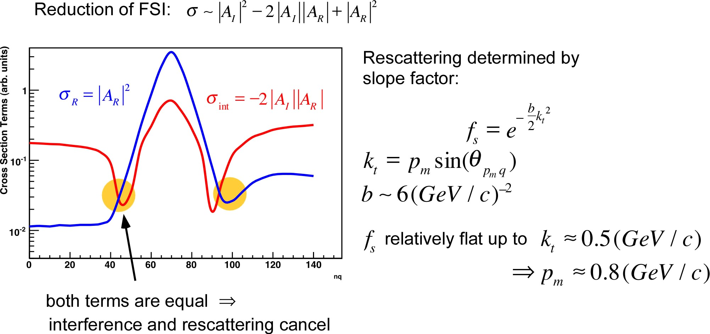
FSI Reduction
b determined by nucleon size
cancellation due to imaginary rescattering amplitude
valid only for high energy (GEA)

